Slide 1

Alameda County HMIS
Monthly User Meeting
October 2025

Slide 2

Agenda
Announcements
LSA and SPM
HUD Data Standards Recap
HUD TA Discussion
Event Reminders
This Photo by Unknown Author is licensed under CC BY

Slide 3

Announcements

Slide 4

LSA & SPM

Slide 5
LSA
What Are They?
SPM
The Longitudinal Systems Analysis (LSA) report is a required HUD report that our community is required to submit annually to HUD across key projects participating in the Continuum of Care (CoC).
The LSA provides HUD and our Continuum of Care (CoC) with critical information about people experiencing homelessness and their use of the system of care.
The System Performance Measures views the local homeless response system as a coordinated system of homeless assistance options instead of programs operating independently in a community.
​
The SPM Allows Continuums of Care (CoCs) to regularly measure progress in meeting the needs of people experiencing homelessness in their community, and to report progress to HUD.

Slide 6
How to Prepare
Access canned reports to support data clean up
[HUDX-225] HMIS Data Quality Report
[HUD-227] Annual Performance Report
[GNRL-220] Program Details Report
Review data & complete updates
If you need support reach out to your Alameda HMIS Administrator or Bitfocus
Be on the lookout for announcements and required follow up

Slide 7
How to Prepare Cont.
Data Element​ Review
Health Insurance (at entry & exit)​
Income (at entry & exit)​
Non-Cash Benefits (at entry)​
Disabling Condition ​
Months or Times Homeless​
Length of Stay​
SSN​
Race & Ethnicity ​
Inventory​
Households​
Overlapping Enrollments​
Pay Close Attention to These Elements

Slide 8

HUD Data Standards Recap & Discussion

Slide 9

HUD Data Standards
Rules and guidelines for collecting, organizing, and sharing data across Homeless Management Information Systems (HMIS) and Housing and Urban Development(HUD) programs to ensure consistency and accuracy.

Slide 10
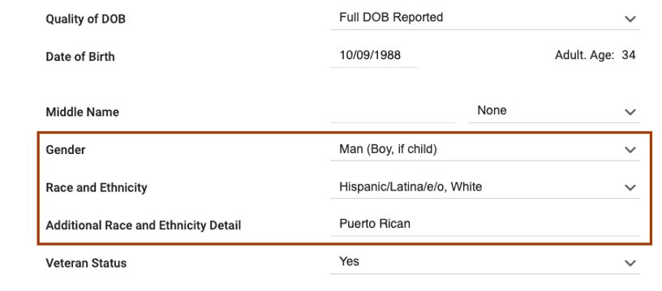
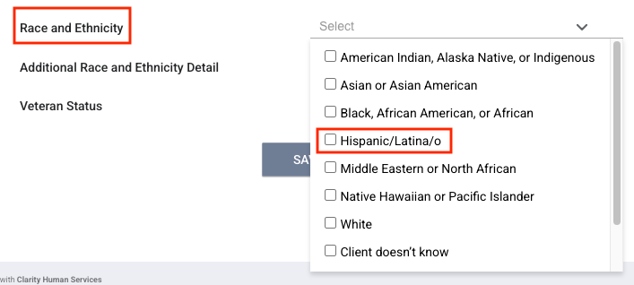
Race & Ethnicity
Before
After

Slide 11
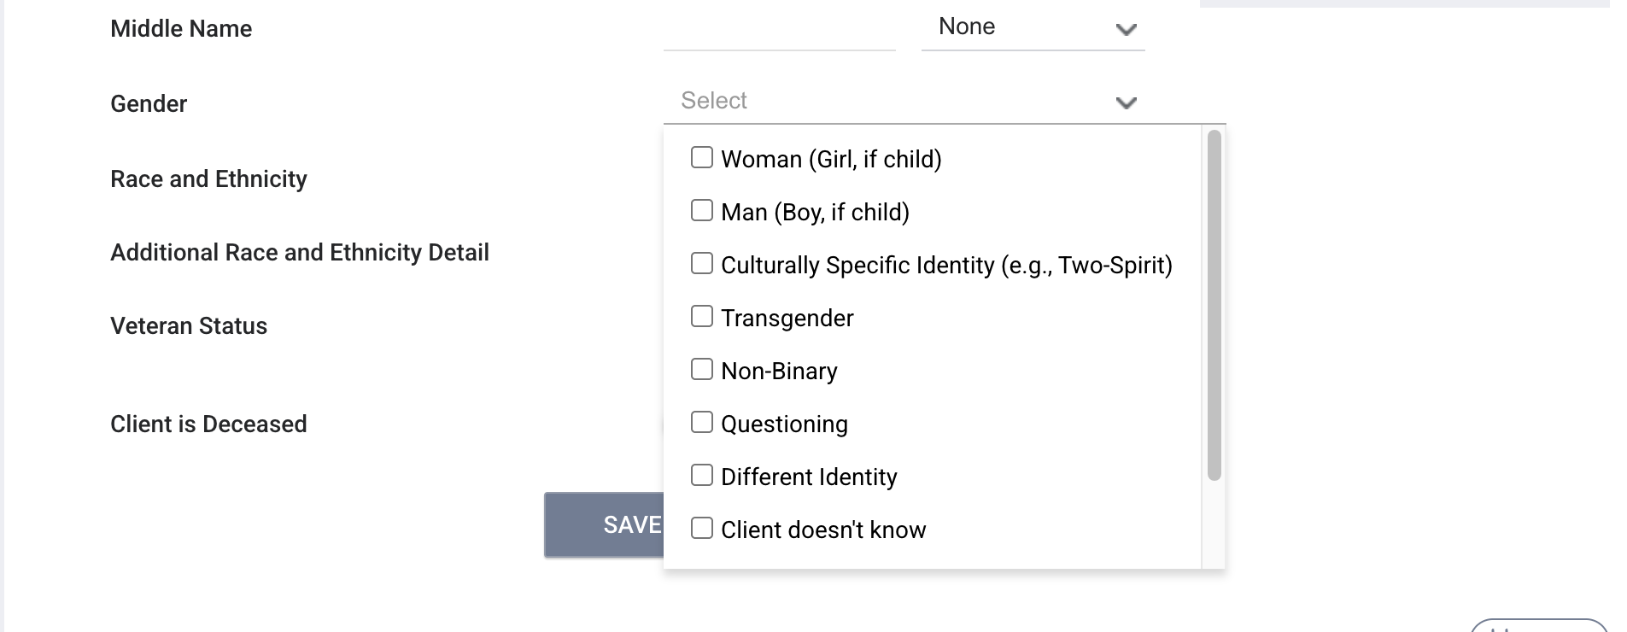
Gender
Before
After
No change on the screen, HUD will not require reporting, but it will still be collected for all clients

Slide 12

Housing Move in Date
Housing Move-in Date must be collected for VA: Grant Per Diem - Case Management/Housing Retention Projects.
VA: Grant Per Diem - Case Management/Housing Retention Projects is a specific and significant funding source from the U.S. Department of Veterans Affairs (VA).
It is a grant program designed to provide financial support to community-based organizations that help homeless veterans and those at risk of homelessness find and retain permanent housing.
New

Slide 13

Sex (Program Enrollment Screen)
Required for HUD reporting
New

Slide 14
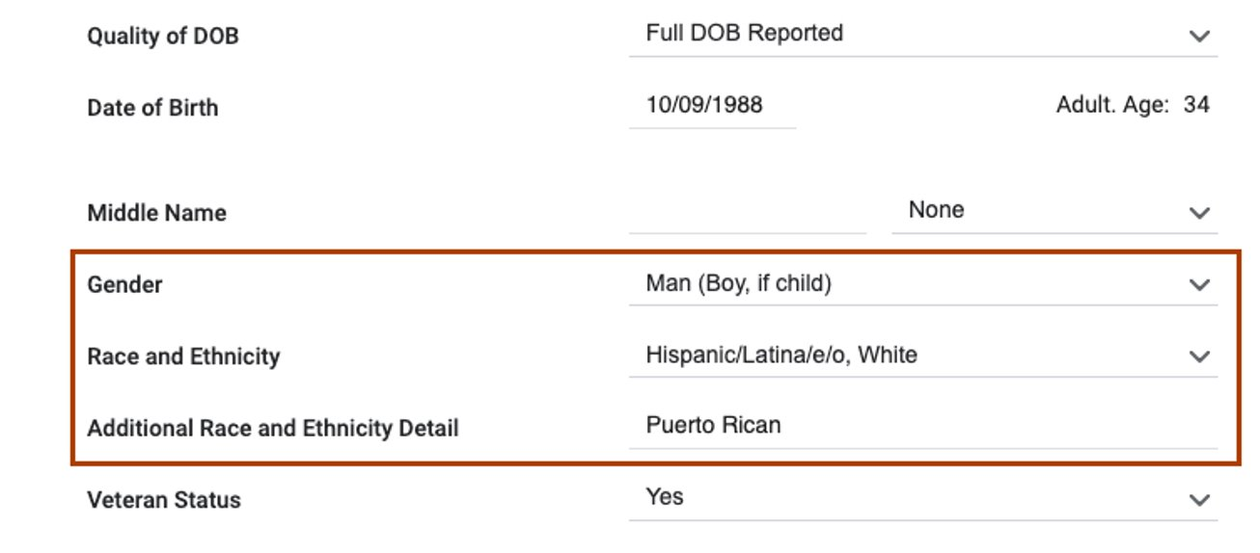
Gender (Profile & Enrollment Screens)
Gender identity question will support capturing client preferences
outside of the newly added sex field
Unchanged

Slide 15
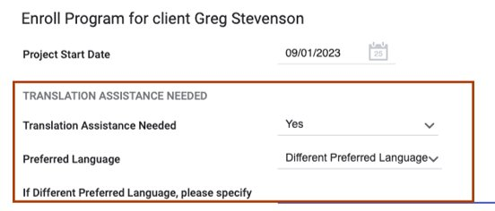
Translation Assistance
Retired field but will still remain on the enrollment screen
Unchanged

Slide 16
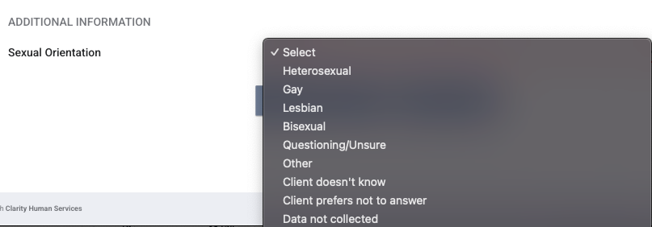
Sexual Orientation
No longer required for HUD reporting but will still be collected
Unchanged for Alameda County

Slide 17
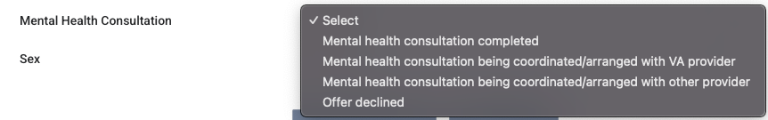
Mental Health Consultation
New field required for the following funding sources
VA: SSVF-funded Homelessness Prevention project
VA: SSVF-funded Rapid Rehousing project
VA: Grant per Diem-Case Management/Housing Retention-funded Services Only project
New

Slide 18

General and Custom Reports
Retired fields will no longer be captured on HUD reports
New fields should be reviewed and updated as needed
Users are encouraged to pull data quality reports to support staying in compliance
Data fields that are not captured by HUD reports can be reviewed via custom reports
Notes:
Sex field and VA housing move in dates

Slide 19
2026 HMIS Data Standards – HUD Resources
New/Updated Report Fields | Retired Report Fields
Race & Ethnicity Label Hispanic/Latina/o | Gender-Required Data Point for Alameda County
CoC Builds Funding Sources | ESG-CV & HOPWA-CV Funding Sources
Sex | Sexual Orientation-Required Data Point for Alameda County
Housing Move In Date-VA Grant Per Diem Projects | Gender-Required Data Point for Alameda County
Mental Health Consultation-Required for Vets | Disabling Conditions VA/VASH Programs
Alameda County will continue to collect data in the retired data fields, retired data field details can be pulled via custom reports

Slide 20

2026 HMIS Data Standards – HUD Resources
All Things Data Standards
HUD TA Team Discussion
Kenisha and Shantae
Notes:
The Mental Health Consultation field will be added to the following system screen:
2026 VA: Project Enrollment screen
The field will be in the Additional Information section below the General Health Status field
Data Quality Check is set to Required
The field will be visible for heads of household and veterans who are being enrolled in any of the following programs:
VA: SSVF-funded Homelessness Prevention project
VA: SSVF-funded Rapid Rehousing project
VA: Grant per Diem-Case Management/Housing Retention-funded Services Only project

Slide 21

Event Reminders
No Monthly User & Liaison Meetings for
November & December
We will see you all next year!

Slide 22

Questions?

Slide 23

Thank You!

