Slide 1

Alameda County
User Meeting
July 2024

Slide 2
Agenda
Sexual Orientation
Services Survey
Data Quality Report

Slide 3


Announcements and Reminders

Slide 4

Data Quality Check
Sexual Orientation

Slide 5



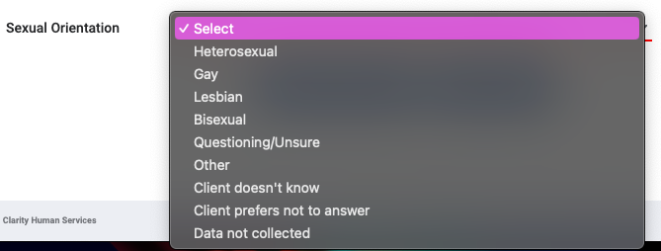
Where is the Sexual Orientation field in Clarity HMIS?
Client Profile
Enrollment Screen
Annual Assessment

Slide 6

When entering Sexual Orientation…
Avoid using the following when possible…
Client doesn’t know
Client prefers not to answer
Data not collected
When selecting “Other,” don’t forget to include the information!

Slide 7

Services Review
Do you use services in your program?

Slide 8
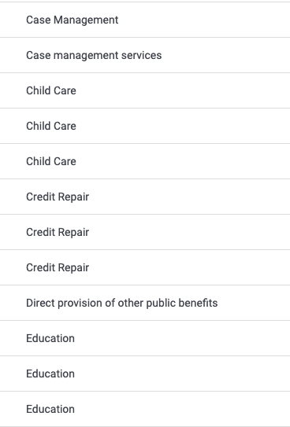

Here is an example that we can help organize!

Slide 9

Data Quality
[HUDX-225] HMIS Data Quality Report

Slide 10
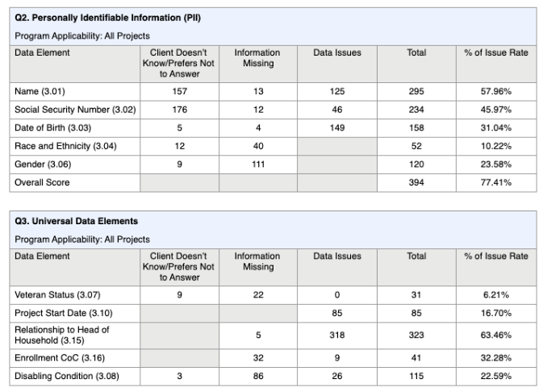
[HUDX-225] HMIS Data Quality Report
What’s you’ll find in the [HUDX-225] HMIS Data Quality Report:
Missing Data
Invalid Social Security Numbers
Latest Project Stay

Slide 11
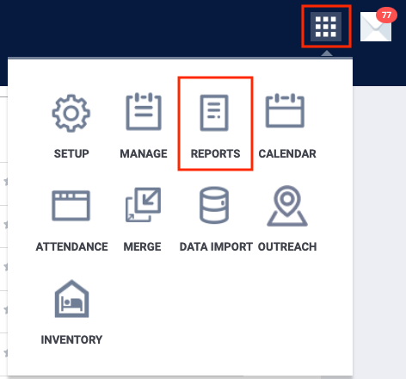
[HUDX-225] HMIS Data Quality Report
Where to find the [HUDX-225] HMIS Data Quality Report:
All users can access the report in the Report Library of Clarity HMIS:
Select the Launch Pad
Select the Reports Icon

Slide 12
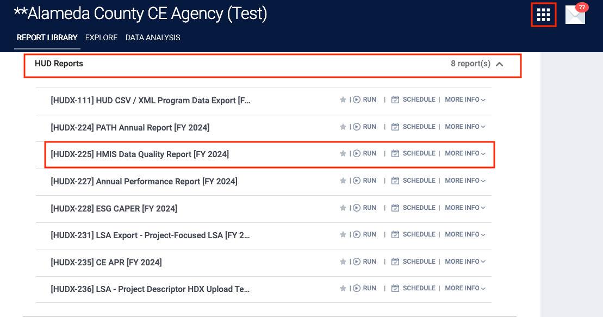
[HUDX-225] HMIS Data Quality Report
Where to find the [HUDX-225] HMIS Data Quality Report:
Open the HUD Reports Folder
Select “Run” for the
[HUDX-225] HMIS Data Quality Report

Slide 13
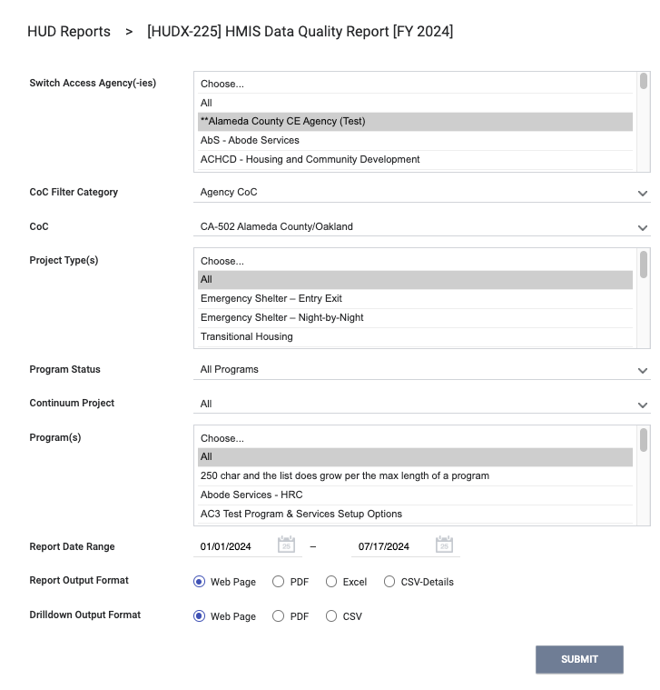

[HUDX-225] HMIS Data Quality Report
Enter your report parameters

Slide 14

Questions?

Slide 15



Join us!
Alameda County Q&A Session
Every 2nd Tuesday of the month at 10:00 am
Register | HERE
Alameda County CE Q&A Session
Every 3rd Tuesday of the month at 10:40 am
Register | HERE
Alameda County User and Liaisons Meeting
Every 4th Thursday of the month
Alameda Users 10a-11a
Agency Liaisons 11a-12p
Register | HERE
Stay tuned for more training dates!
Coming soon!

Slide 16

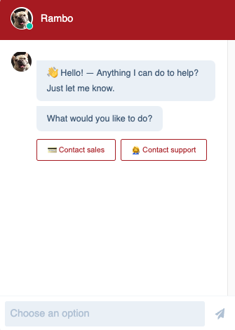

For support:
Alameda County HMIS Support Ticket:
Email: hmissupport@achmis.org
Bitfocus Help Desk:
For support that includes:
New User Requests (Including CE)
Password Reset
Login Issues
Chat

Slide 17
Alameda County
Liaisons Meeting
July 2024

Slide 18
Agenda
Sexual Orientation
Services Survey
Data Quality Report

Slide 19
Announcements and Reminders

Slide 20
Data Quality Check
Sexual Orientation

Slide 21
Where is the Sexual Orientation field in Clarity HMIS?
Client Profile
Enrollment Screen
Annual Assessment

Slide 22
When entering Sexual Orientation…
Avoid using the following when possible…
Client doesn’t know
Client prefers not to answer
Data not collected
When selecting “Other,” don’t forget to include the information!

Slide 23
Services Review
Do you use services in your program?

Slide 24
Here is an example that we can help organize!

Slide 25
Data Quality
[HUDX-225] HMIS Data Quality Report

Slide 26
[HUDX-225] HMIS Data Quality Report
What’s you’ll find in the [HUDX-225] HMIS Data Quality Report:
Missing Data
Invalid Social Security Numbers
Latest Project Stay

Slide 27
[HUDX-225] HMIS Data Quality Report
Where to find the [HUDX-225] HMIS Data Quality Report:
All users can access the report in the Report Library of Clarity HMIS:
Select the Launch Pad
Select the Reports Icon

Slide 28
[HUDX-225] HMIS Data Quality Report
Where to find the [HUDX-225] HMIS Data Quality Report:
Open the HUD Reports Folder
Select “Run” for the
[HUDX-225] HMIS Data Quality Report

Slide 29
[HUDX-225] HMIS Data Quality Report
Enter your report parameters

Slide 30
Questions?

Slide 31
Join us!
Alameda County Q&A Session
Every 2nd Tuesday of the month at 10:00 am
Register | HERE
Alameda County CE Q&A Session
Every 3rd Tuesday of the month at 10:40 am
Register | HERE
Alameda County User and Liaisons Meeting
Every 4th Thursday of the month
Alameda Users 10a-11a
Agency Liaisons 11a-12p
Register | HERE
Stay tuned for more training dates!
Coming soon!

Slide 32
For support:
Alameda County HMIS Support Ticket:
Email: hmissupport@achmis.org
Bitfocus Help Desk:
For support that includes:
New User Requests (Including CE)
Password Reset
Login Issues
Chat

