Slide 1
Alameda County
Clarity HMIS – General Refresher Training
April 2025

Slide 2
Agenda
Introductions
Client Profiles and Household Management
Client Contact and Location information
Enrollment and Exits
Reports
Confidential and Proprietary ⎢ © Copyright 2022 Bitfocus, Inc., All Rights Reserved.

Slide 3
Creating New Client Profiles Searching for, creating new & connecting profiles

Slide 4
Creating New Profiles - Searching for Clients in Clarity
Search by:
Search by name, partial name, DOB, or SSN
Create
If unable to find, create a new profile

Slide 5
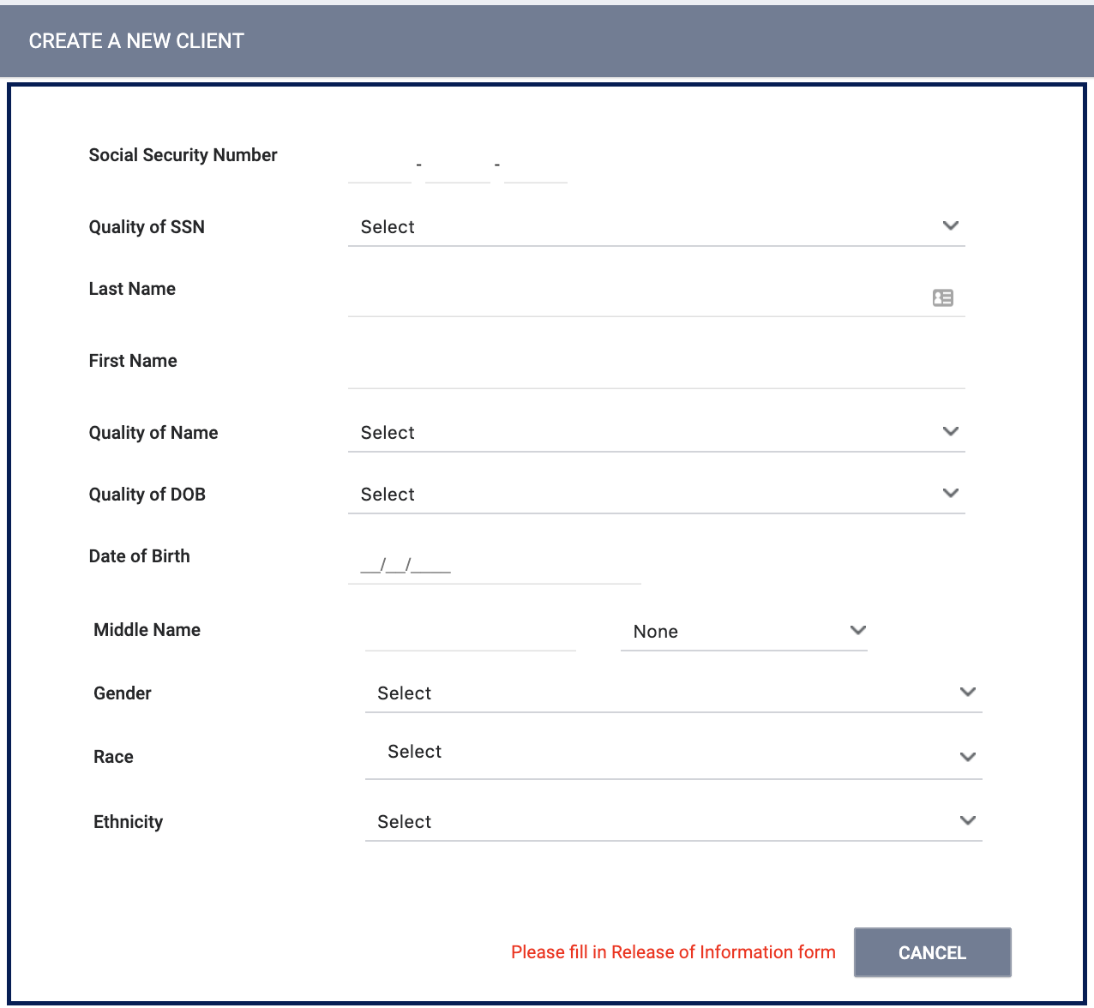
Creating New Profiles
Please make sure to collect as much information as possible, and avoid using “Client Refused” or Data Not Collected” whenever possible
For existing profiles, confirm that all information is correct and up to date
Confidential and Proprietary ⎢ © Copyright 2022 Bitfocus, Inc., All Rights Reserved.

Slide 6
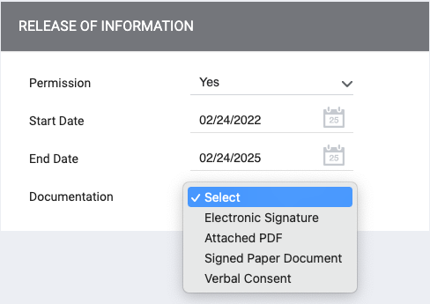
Client Consent
Informed Consent:
Client should understand what they are consenting to.
Consent form (ROI) should be available for the client to review and take
Consent Duration:
Clients only need to consent once which is good for 10 years after the last HMIS activity.
Adding an ROI to a New Client Record:
The information box to the right must be completed
Consent Documentation
Electronic Signature: E-Sign Document button will display
Attached PDF: Select File button will display to upload file
Signed Paper Document: Enter your location in the Location text box
Verbal Consent: Select if the client verbally gave consent

Slide 7
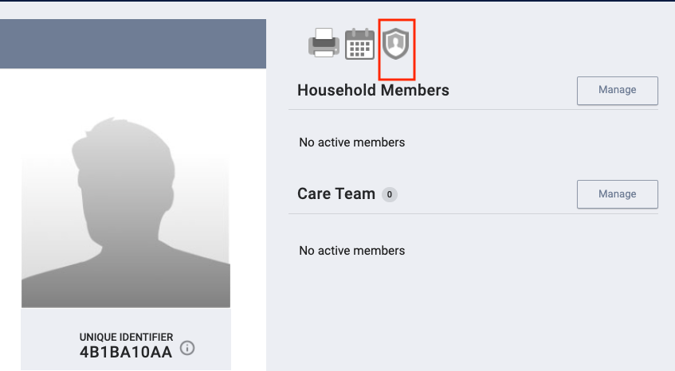
Managing Consent with Existing Client Records
Select the Shield icon on the client’s profile
The client’s privacy page will display previous records
Select the Edit icon beside the record to update or the Add icon to create a new record

Slide 8
Connecting Clients to Create a Household
The Household Members section will be listed at the top of the right sidebar.
Select “Manage” to the right of the section Household Members
You will be taken to Household Management search screen.
Confidential and Proprietary ⎢ © Copyright 2022 Bitfocus, Inc., All Rights Reserved.

Slide 9
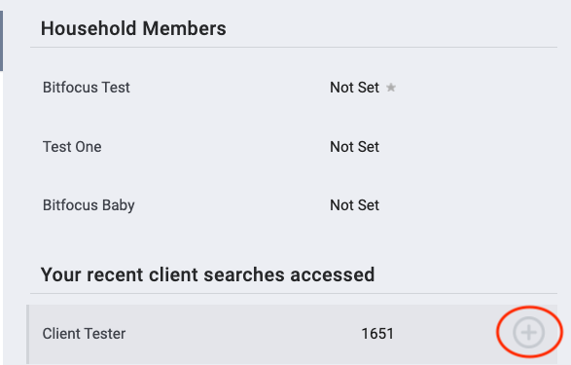
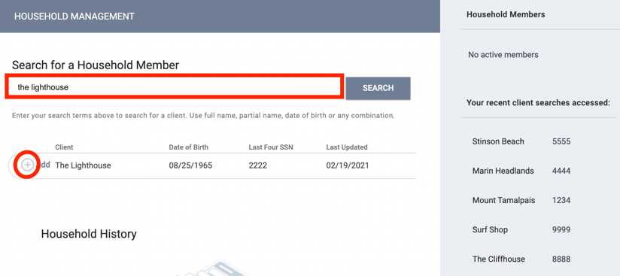
You can add new household members in two ways:
Quick Add: Within the right sidebar, your 10 most recently searched client records will appear. Generally, Household members are added to the system sequentially, therefore they will likely be listed here
Search the Search Bar: If the Household members are not listed in the recent search section, you can search for them in the search bar.
Confidential and Proprietary ⎢ © Copyright 2022 Bitfocus, Inc., All Rights Reserved.

Slide 10
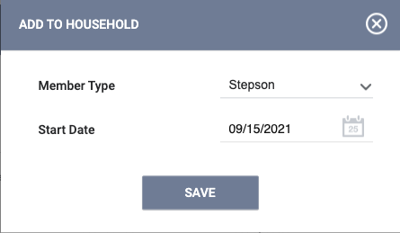
Managing Households
Selecting the plus or join icon
Set Member Type and Start Date
Confidential and Proprietary ⎢ © Copyright 2022 Bitfocus, Inc., All Rights Reserved.

Slide 11
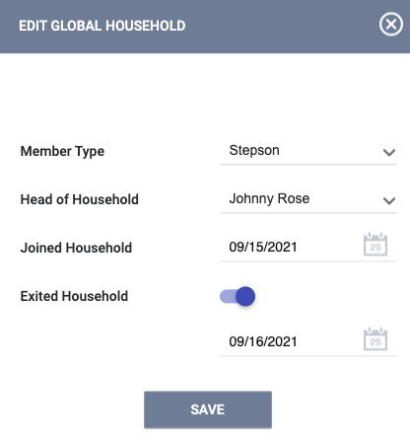
Editing a Household
Select the edit icon under Household Members
Update information or toggle
on exit
Confidential and Proprietary ⎢ © Copyright 2022 Bitfocus, Inc., All Rights Reserved.

Slide 12
Entering Client Contact and Location Information

Slide 13
Creating Contact Records
To create a contact record, click the CONTACT tab within the client record and click ADD CONTACT.
Confidential and Proprietary ⎢ © Copyright 2022 Bitfocus, Inc., All Rights Reserved.

Slide 14
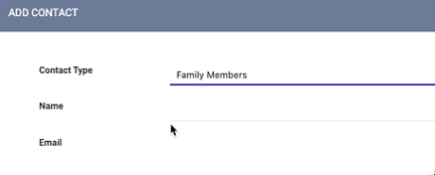
Creating Contact Records
Select an appropriate Contact Type and enter an email address, phone number, or both, for the contact.
You can turn off the Active Contact toggle if the contact is no longer accurate.
Select a Date to associate with the contact and, if applicable, add a Note.
To view and/or edit a record, hover over it from the CONTACT tab and click the edit icon.
Confidential and Proprietary ⎢ © Copyright 2022 Bitfocus, Inc., All Rights Reserved.

Slide 15
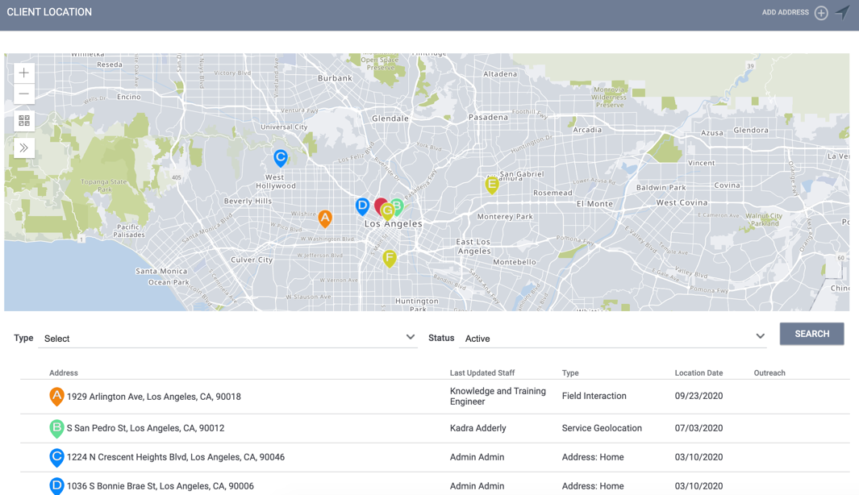
Location Tab Overview
Location refers to client's geographic location information
You can access the Location tab by clicking LOCATION in the client record.
Historical location information is stored here as well
Confidential and Proprietary ⎢ © Copyright 2022 Bitfocus, Inc., All Rights Reserved.

Slide 16
Enrollment Clients Into Programs

Slide 17
Once the client profile is located and any contact info updated, you will click on Programs to enroll the client into your program

Slide 18
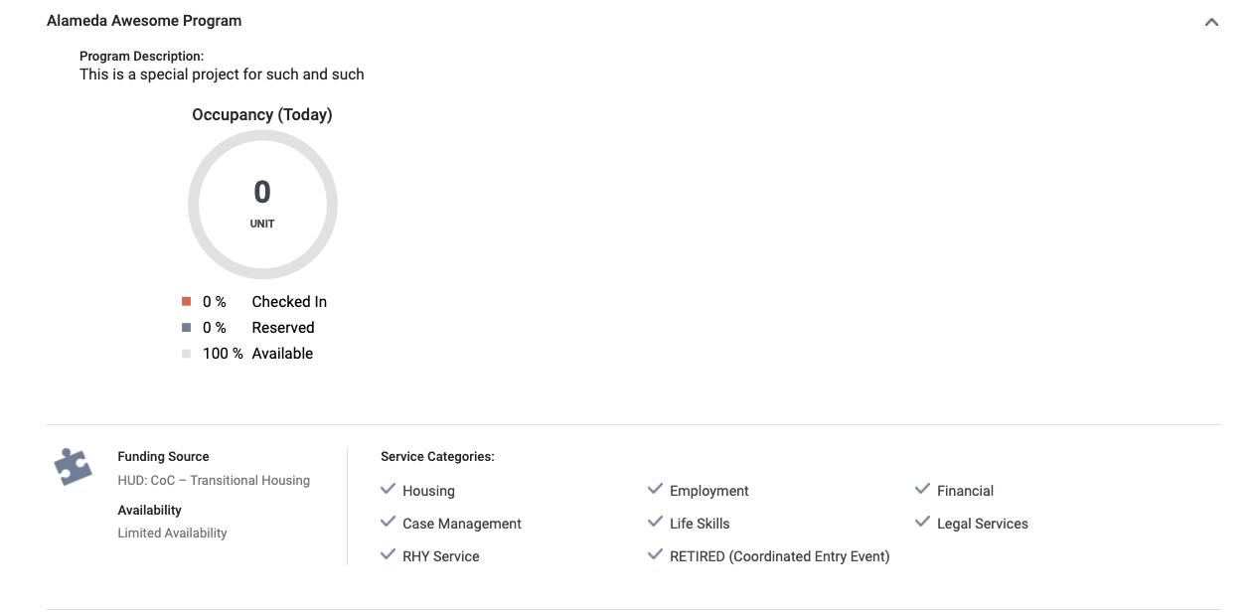
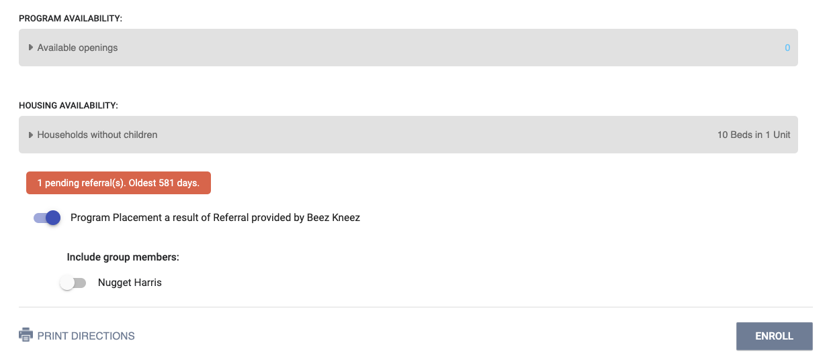
When you select the program, you will see:
Enrollments
Vacancy
Referrals
Pending referrals will be “complete” once enrolled, if applicable.
Toggle on household members, if applicable.

Slide 19
Recording Assessments

Slide 20
Current Living Situation
Accurately capture clients current living situation experiencing homelessness.
Document Homeless Chronicity
Capture Imminent Risk of Homelessness
Understand how many times a person is engaged while experiencing homelessness
Required for the following:
Coordinated Entry Programs
Night-by-Night Shelters
Street Outreach Programs
Services Only Programs
YHDP Programs

Slide 21
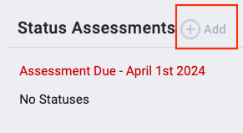
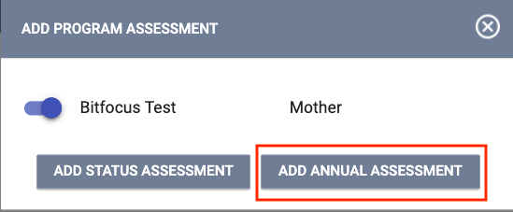
Annual Assessment
Required for enrollments open for 365+ days
To get to the Annual Assessment, you must navigate to their active program
Click Add next to Status Assessments and then select the client(s) for which you want to conduct the annual assessment
You can also add an Annual Assessment from the Program Assessments tab.

Slide 22
Exiting a Client

Slide 23
Why is exit destination data important?
Determines the effectiveness of your program and gaps in service
Directly impacts the goals of the HMIS
Document episodes of homelessness that can support clients through the coordinated entry process

Slide 24
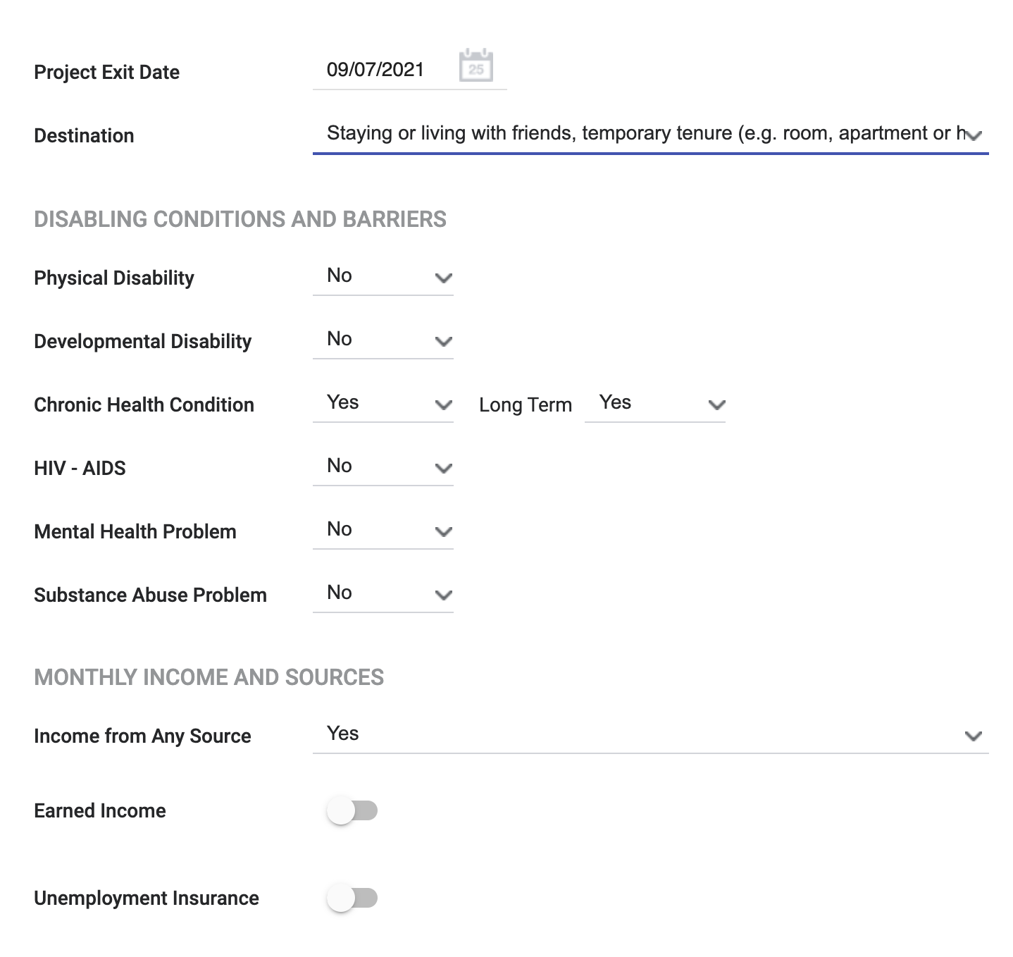
Exiting clients from a program
Identify where the client will be staying after being exited from your program (that night).
Enrollment data will auto-populate to the exit screen except the Exit Destination
The clients’ Exit Destination must be entered at the time they are being exited from the program.
Data Not Collected, No Exit Interview Completed, and Other are considered “missing data”– avoid using when possible
Confidential and Proprietary ⎢ © Copyright 2022 Bitfocus, Inc., All Rights Reserved.

Slide 25
Running Reports and Measuring Outcomes

Slide 26
Key Reports
[GNRL-106] Program Roster
[HUDX-227] Annual Performance Report [FY 2024]
[HUDX-225] HMIS Data Quality Report [FY 2024]
[DQXX-102] Program Data Review
Confidential and Proprietary ⎢ © Copyright 2022 Bitfocus, Inc., All Rights Reserved.

Slide 27
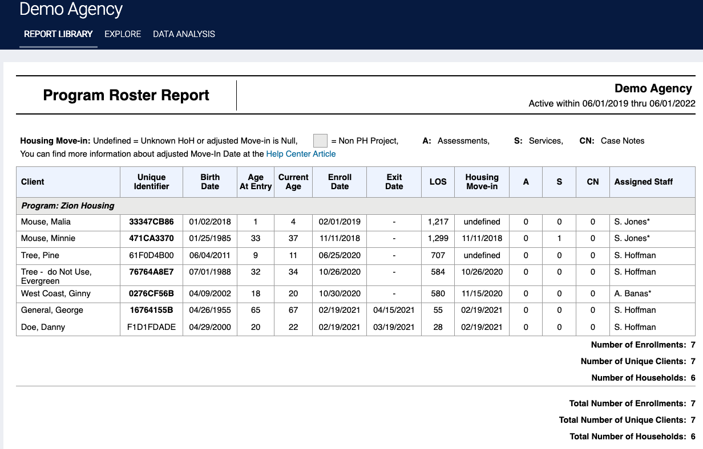
[GNRL – 106] Program roster report
This program-based report lists program stay information for selected programs and status according to specified report dates.

Slide 28
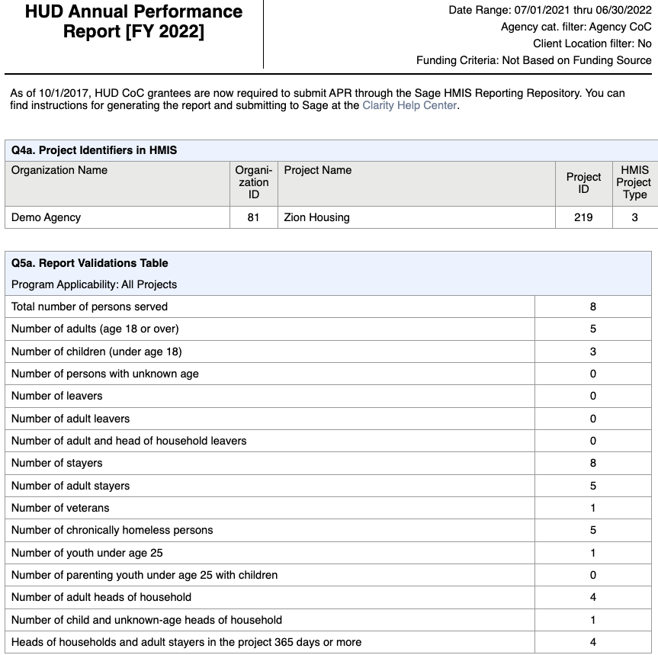
[HUDX– 227] Annual Performance Report [FY 2024]
Recipients of HUD Continuum of Care (CoC) funding (e.g., Supportive Housing Program, Shelter Plus Care, Section 8 Moderate Rehabilitation Single Room Occupancy Program, CoC Program) are required to submit an Annual Performance Report (APR) electronically to HUD every operating year.

Slide 29
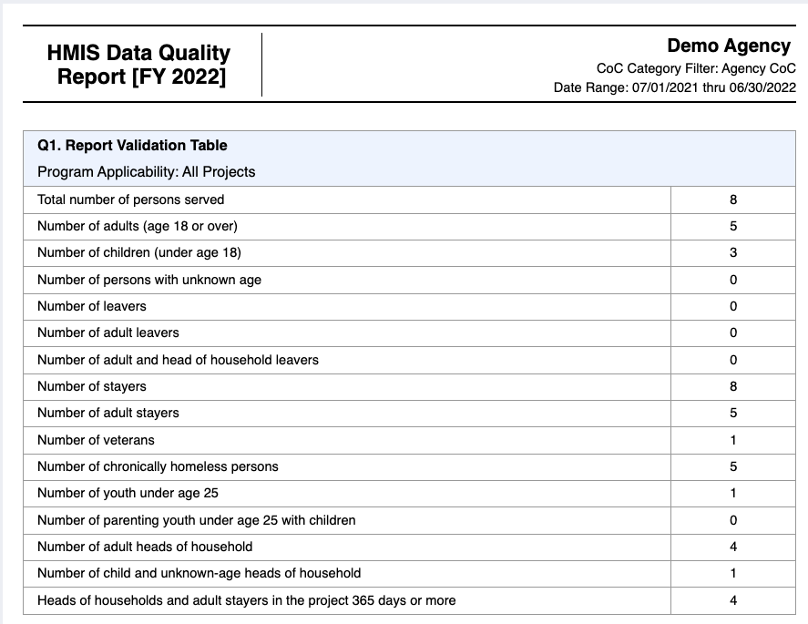
[HUD -225] HMIS Data Quality Report [FY 2024]
The [HUDX-225] HMIS Data Quality Report is a HUD report that reviews data quality across several HMIS data elements.

Slide 30
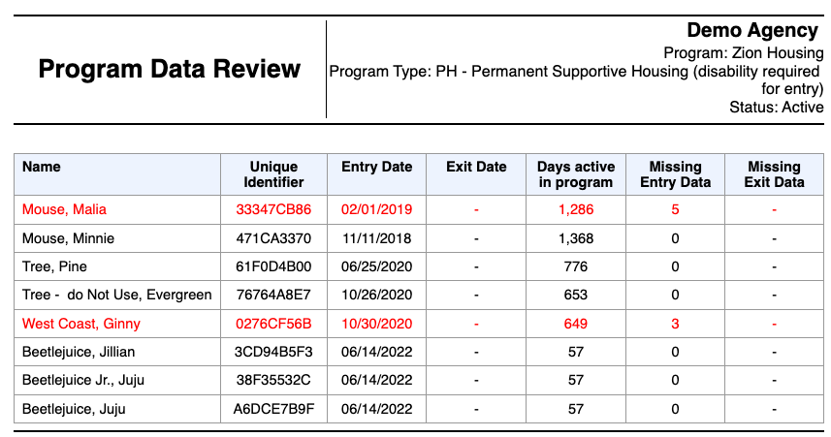
[DQXX – 102] Program Data Review
This program enrollment-based report utilizes information from both the enrollment screen and, if applicable, the exit screen.

Slide 31
QUESTIONS?

Slide 32
Additional
Resources
Alameda County HMIS Website:
Email: alameda.bitfocus.com
Alameda County HMIS Technical Support:
Email: hmissupport@achmis.org
Bitfocus
For support with:
New User Requests
Password Reset
Login Issues
Email: Alameda@bitfocus.com
Phone: (408) 429-5046
Events:
Alameda County HMIS Q&A Session | Register HERE
Alameda County Coordinated Entry Q&A Session | Register HERE
Alameda County User and Liaisons Meeting | Register HERE

